Slide 1




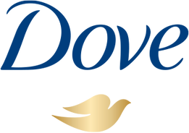
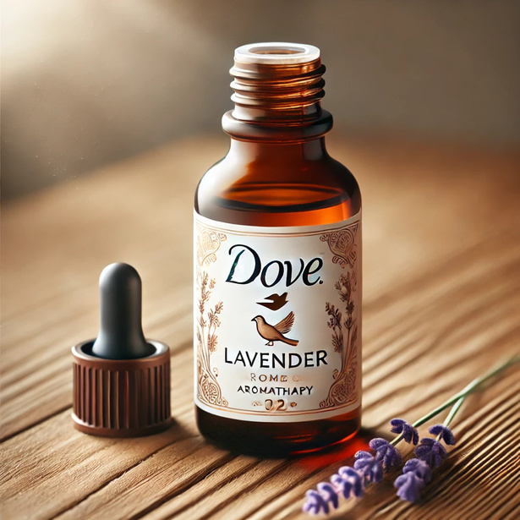
Marketing Analysis & Planning
Dove - Relaxation & Wellness
SUKHMANI KAUR (301467664)
SUKHPREET SINGH (301333453)
MANKANWAR SINGH (301330855)

Slide 2
Table of Contents
Executive Summary
Project Definition
Situational Analysis
Key Findings
Market values and growth trends
Our competitors
Conclusion- STEEP Analysis
Target Area- Benchmark
Custom variable
Profile variables
Target groups
Why family as target group?
Scorecard of target group
Area of Interest- Young
Area of Interest- Family
Demographic
Behavioural
Social values
Media
Marketing Plan
Customer Journey
Stage 1: Awareness
Stage 2: Engagement
Stage3: Conversion
Stage 4: Retention
Campaign Ideas
Metrics for Dove
Budget estimates
References

Slide 3
Executive Summary
The campaign for Dove’s “Relaxation & Wellness” initiative is grounded in insights from market analysis and target audience profiling. Research highlights a growing consumer demand for self-care solutions amidst increasing stress levels. Dove is uniquely positioned to address this demand through its trusted reputation for nurturing and high-quality personal care products.
The proposed strategies combine authentic storytelling, strategic influencer partnerships, and engaging community-driven events to create a holistic marketing approach. This report outlines specific actions and recommendations to implement the campaign effectively.

Slide 4
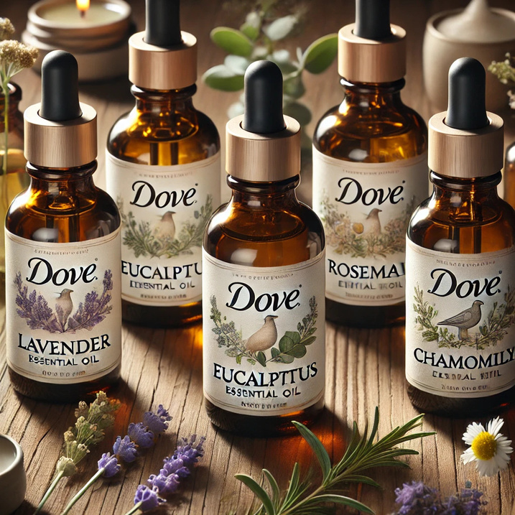
Project Definition
The aim is to develop a new Dove skincare line with integrated aromatherapy benefits, targeted at consumers who look for stress relief and holistic wellness. This research will determine the market potential in Toronto, the customer triggers toward wellness-oriented skincare, and analyze attitudes toward aromatherapy, essential oils, and sustainability. Demographics, behaviors, and psychographics will be focused on self-care and eco-conscious consumers, by exploring natural ingredients preferences, eco-friendly packaging, and premium pricing. Insights will guide the creation of body washes, lotions, and bath soaks, addressing market demand for relaxation-oriented, environmentally conscious skincare.

Slide 5
Situational Analysis
SOCIAL
TECHNOLOGY
ECONOMIC
Ptial Market Growth Inflation and Spending Patterns Local Competition Employment Trends
Premium Pricing Potential Market Growth Inflation and Spending Patterns Local Competition Employment Trends
Increased Focus on Self-Care
Cultural Trends
Health Consciousness
Lifestyle Changes
Product Innovation
Sustainability in Production
Digital Marketing
E-commerce
Premium Pricing Potential
Market Growth
Inflation and Spending Patterns
Local Competition
Employment Trends

Slide 6
Situational Analysis
ENVIRONMENTAL
POLITICAL
Sustainable Practices
Climate Awareness
Regulatory Pressures
Natural Ingredients
Government Regulations
Environmental Policies
Trade Policies
Tax Incentives
Consumer Protection Laws

Slide 7
Summary of key findings
Social- Millennials and Gen Z are increasingly prioritizing self-care, seeking stress relief and natural remedies. They prefer products with natural, organic, and cruelty-free ingredients, with a post-pandemic focus on mental wellness driving interest in relaxation-focused skincare.
Technological- Innovative eco-production and aromatherapy integration in skincare rely on digital marketing, influencer partnerships, and data-driven strategies to engage tech-savvy, wellness-focused consumers. Online platforms play a key role in product distribution.
Economic- Wellness-oriented skincare can command a high price due to its perceived value. Despite inflation, the aromatherapy and natural skincare market is growing, driven by eco-conscious consumers. Strong differentiation is crucial in Toronto's competitive market.

Slide 8
Summary of key findings
Environmental- Sustainability is essential, with consumers expecting natural ingredients, biodegradable packaging, and low carbon footprints. Sustainably sourced essential oils enhance brand appeal and align with Canadian environmental standards.
Political- Canadian regulations protect consumers from misleading aromatherapy claims. Government policies, like the single-use plastics ban, support eco-friendly brands and offer opportunities such as potential tax incentives for adopting green practices.

Slide 9
Market value & growth trends
The Canadian skin care market is projected to reach a volume of US$2.14 billion in 2024, with an annual growth rate of 2.12% from 2024 to 2029.
The broader beauty and personal care market is expected to generate US$8.84 billion in revenue in 2024, with a projected annual growth rate of 1.54% from 2024 to 2029.
Globally, the skincare market was valued at USD 109.71 billion in 2023 and is projected to grow to USD 194.05 billion by 2032, exhibiting a CAGR of 6.68% during this period.

Slide 10
Our competitors
Ember Wellness
Provides clean, supportive skincare products designed to be part of daily rituals, focusing on wellness and self-care.
Health Hut
Offers clean skincare, body, and lifestyle products, incorporating facial-forward brands and focusing on wellness.
Wildcraft
Creates small-batch, organic skincare products, emphasizing natural ingredients and eco-friendly practices.

Slide 11
Conclusion- STEEP
Increasing Demand for Holistic Wellness Products:
Growing emphasis on self-care, stress relief, and mental well-being present a considerable market opportunity for wellness-oriented skincare products.
The blend of aromatherapy fits seamlessly with customers' preferences for natural and effective means of reducing stress.
Innovation and Sustainability Dominance:
Formulating progressive products and shifting to sustainable production systems are vital if the Dove skincare range is to stand apart from its competitors.
The establishment of sustainable variables like biodegradable packaging and responsible sourcing of ingredients could make this product more appealing for environmentally conscious consumers.
Justification of premium pricing:
Consumers are willing to pay more for prestige products that sufficiently afford wellness benefit, sustainability, and quality ingredients.
The product line extension should cherish dignity over the Dove brand, yet even it will take a long, aggressive and all-out militant marketing activity over time.
Target Marketing Opportunities:
Tech-savvy Millennial and Gen Z audiences can be chiefly reached through digital marketing and influencer strategies.
Personalization and data-driven insights can customize products and campaigns based on consumer needs and preferences.

Slide 12
Regulatory and Compliance Alignment:
Compliance with Health Canada regulations alongside honesty in communicating aromatherapy benefits is key in establishing trust and credibility.
Compliant with environmental policies further reinforces the brand’s commitment to sustainability.
Competitive Differentiation:
It will, however, be a very competitive market in the city of Toronto, with brands like The Body Shop and Burt's Bees already established. Dove now has to focus on unique value propositions, such as claims to aromatherapy benefits well supported by the evidence and greater environmental responsibility.
Positioning within Global Trends:
Demand for natural and wellness-related products is on the rise, and positioned to make this an offering extending beyond Toronto, given proper scale-up and branding.
Strategic Implication
Dove aromatherapy skincare has a tremendous opportunity in Toronto as long as wellness, sustainability, premium quality, and transparency are well emphasized. Innovative formulations, eco-friendly practices, and focused marketing will beautifully guide the establishment of a highly strong presence in the wellness-oriented skincare segment.

Slide 13
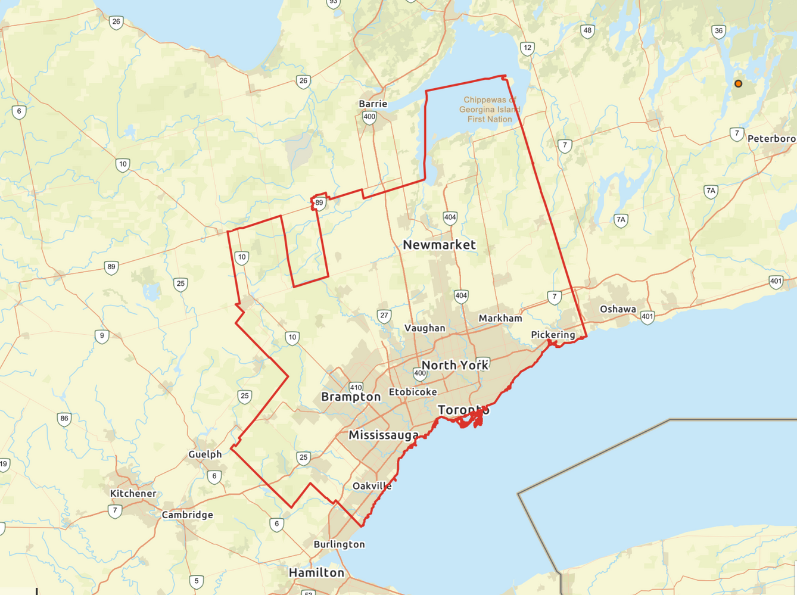
Target Area- Benchmark

Slide 14
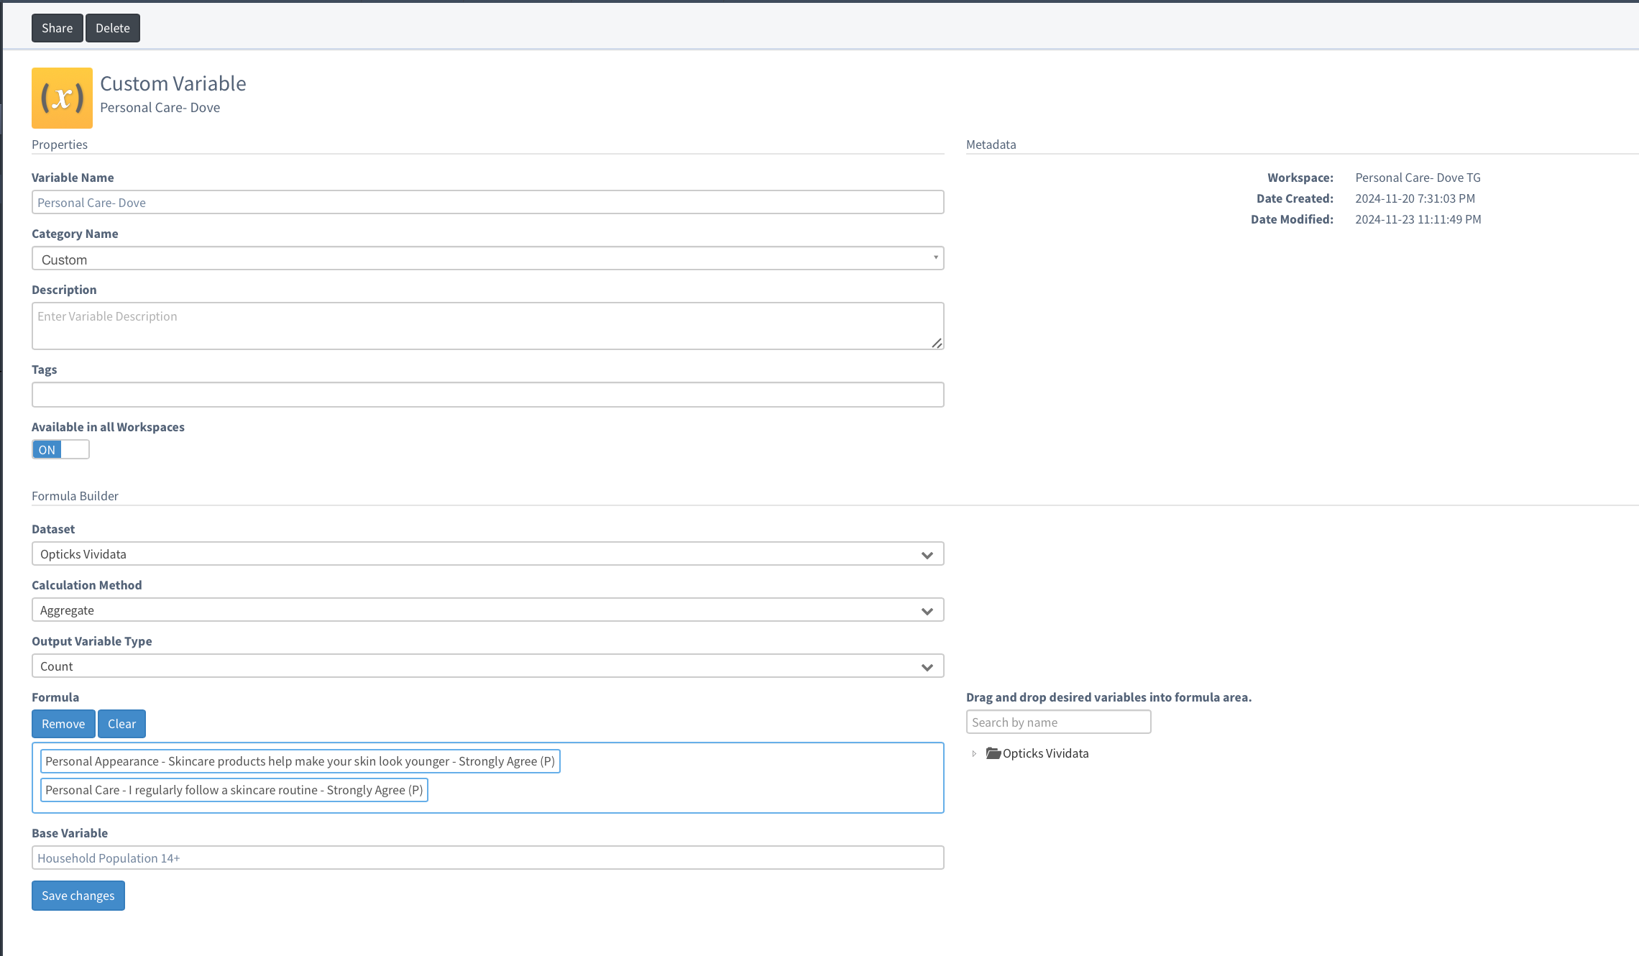
Custom Variable

Slide 15
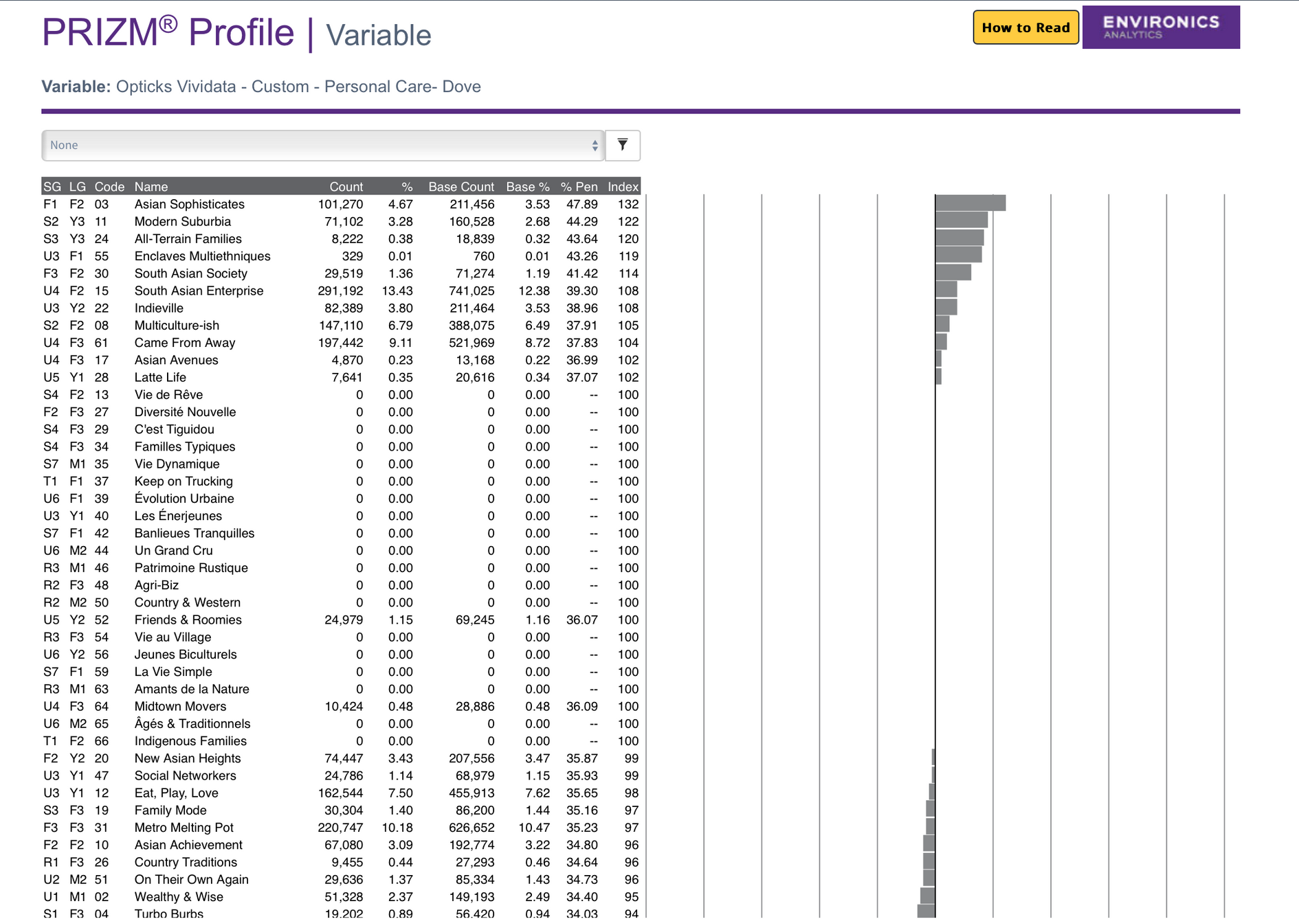
Profile Variables

Slide 16
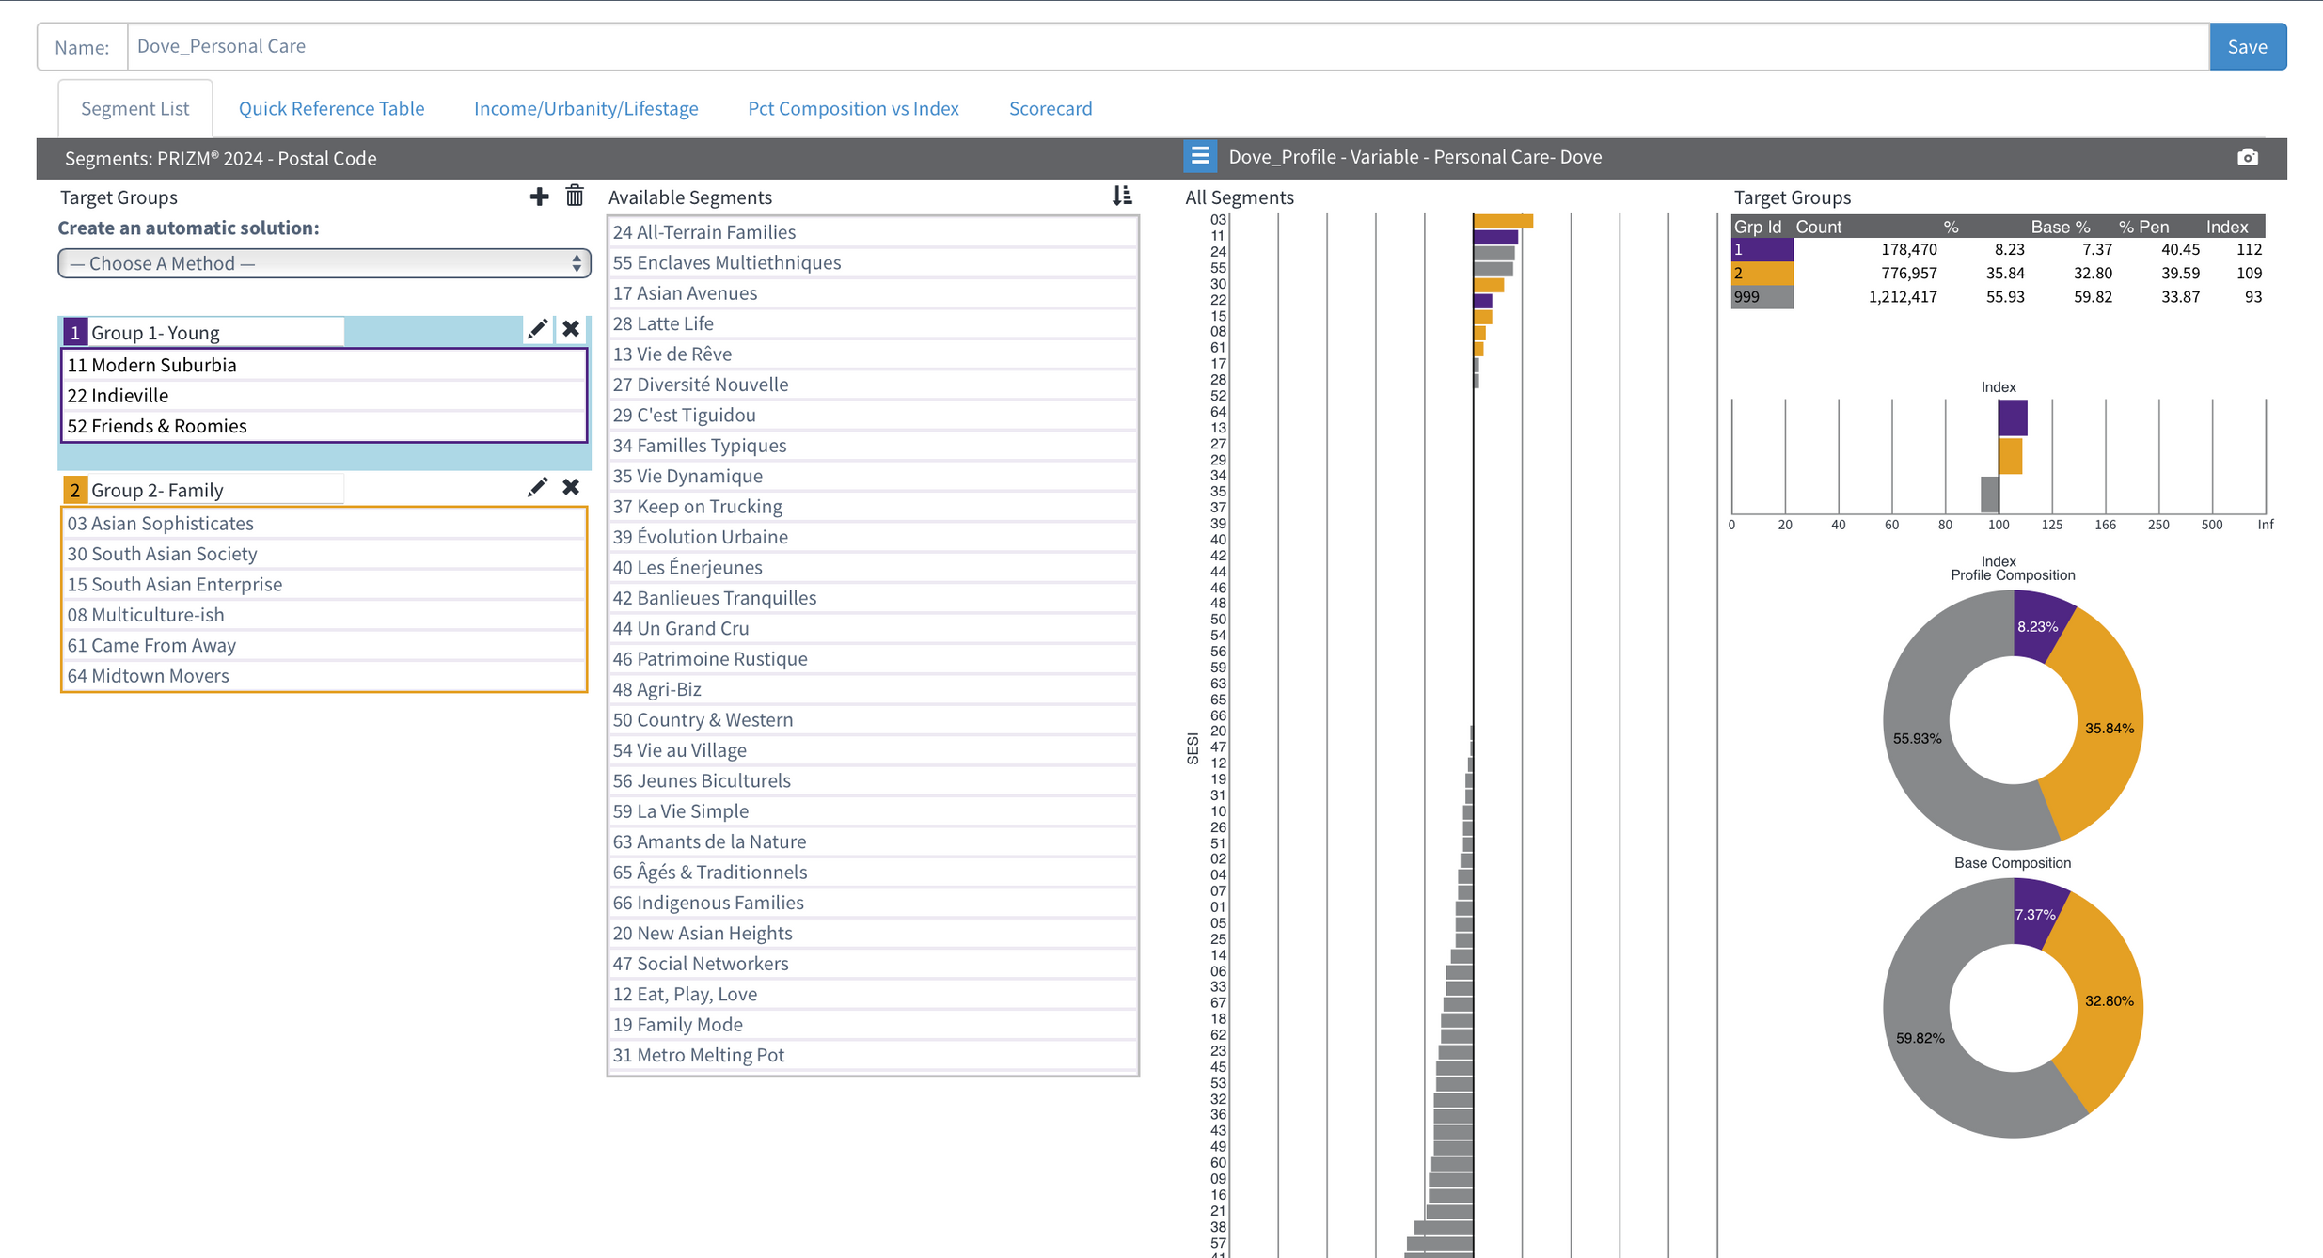
Target Groups

Slide 17
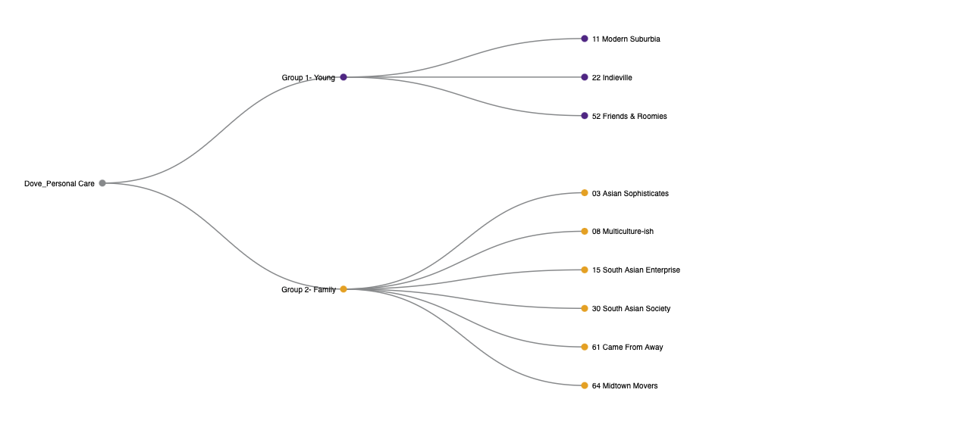

Slide 18
Why Family as target group?
Larger Base: Group 2 had a share of substance 35.84%, compared with Group 1's really small 8.23%. A larger consumer base will accrue in Group 2. More customers in compleasing time will help boost sales.
Higher Index: The index for Group 2 is 109 which indicates greater propensity than average for this segment to use Dove, making it favorable to target.
Higher Penetration: The penetration level in Group 2 is 39.59 because Family is larger in quantity than Group 1 (Young) at 7.37. It indicates a big chunk of consumers in the Family set already consumed Dove products, thus creating a strong market presence.
Alignment with Family Values: Dove is often marketed around care, gentleness, and family. The Family would probably buy into such messaging because it sees the need for products that address the family as a whole.

Slide 19
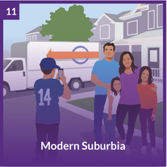
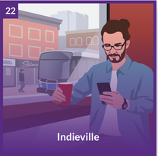

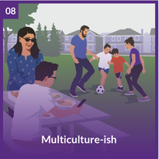
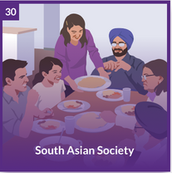
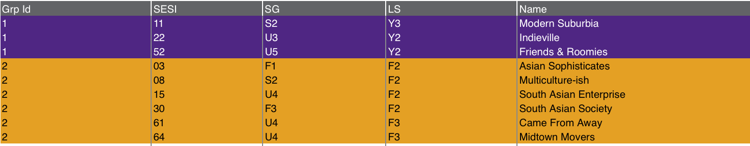
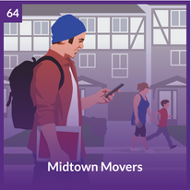
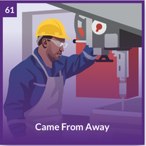
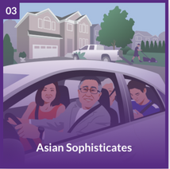
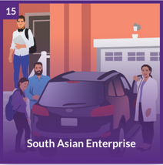
Scorecard of target group

Slide 20
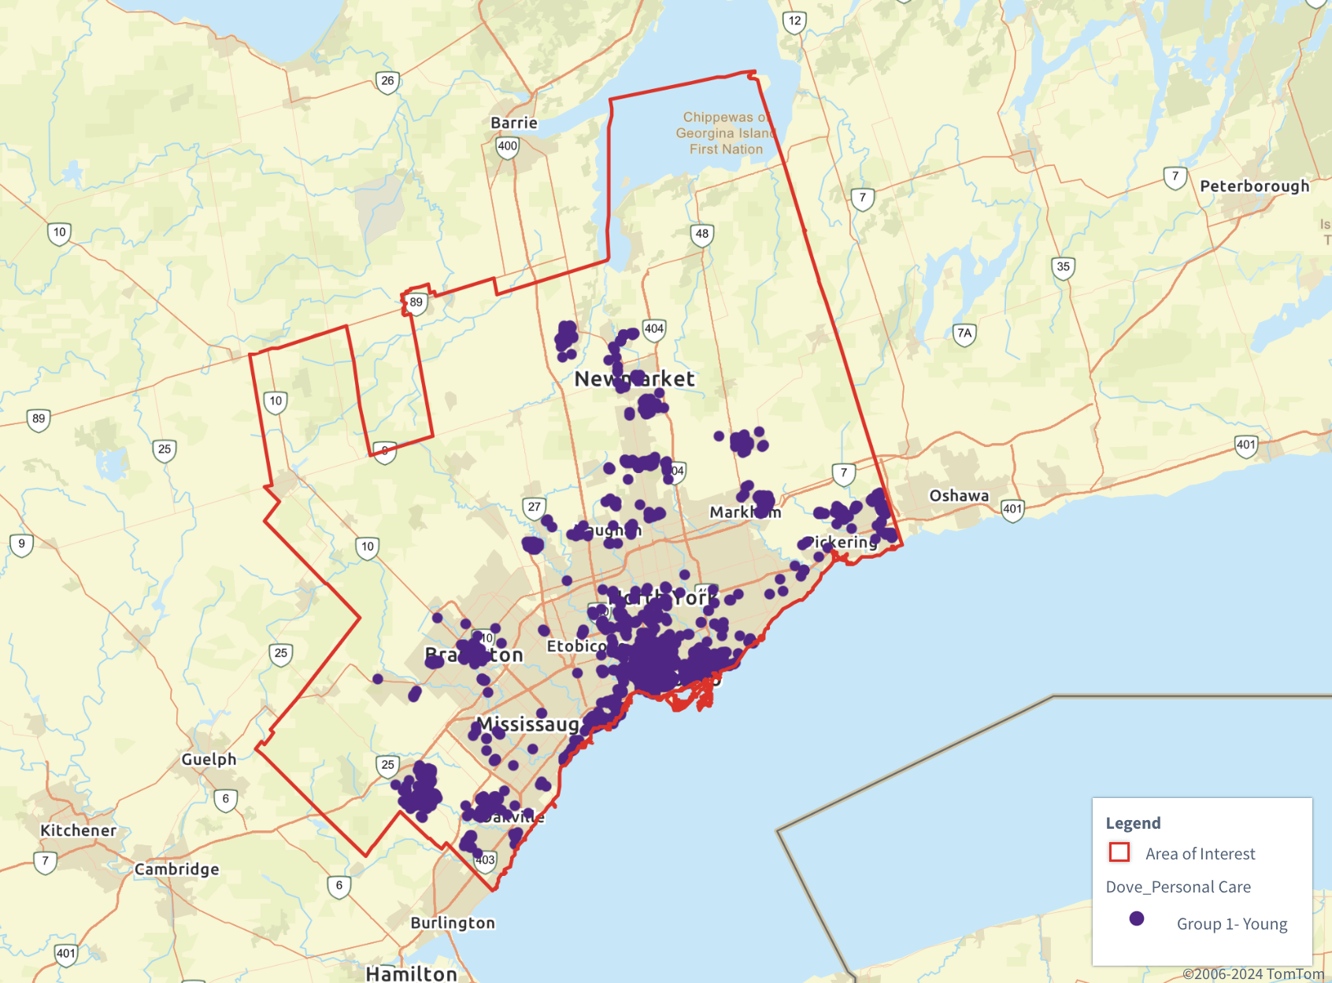
Area of Interest- Young

Slide 21
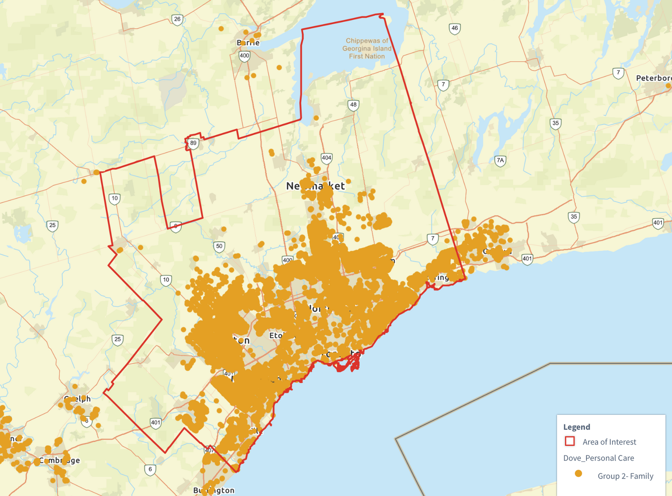
Area of Interest- Family

Slide 22
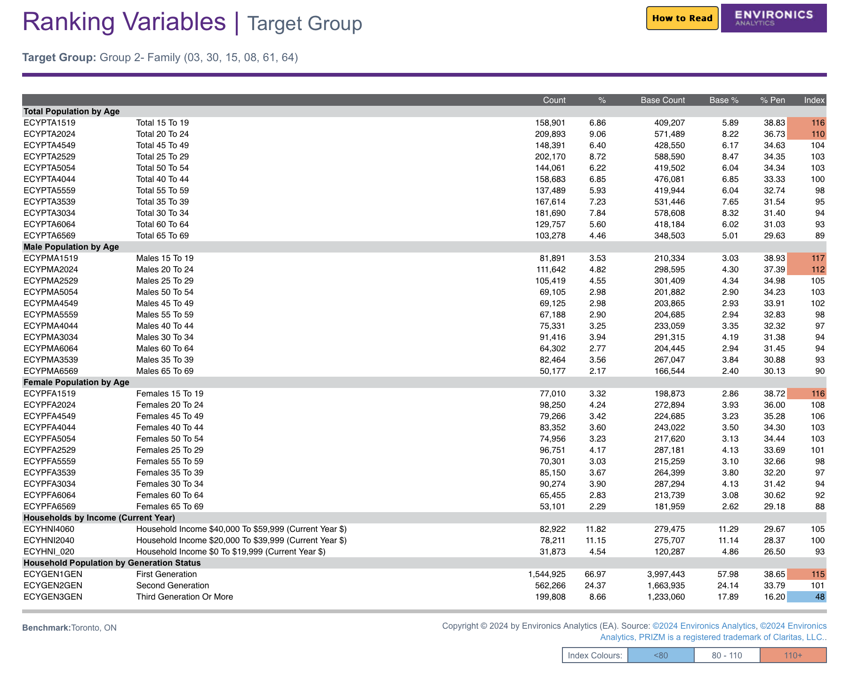
Demographics

Slide 23
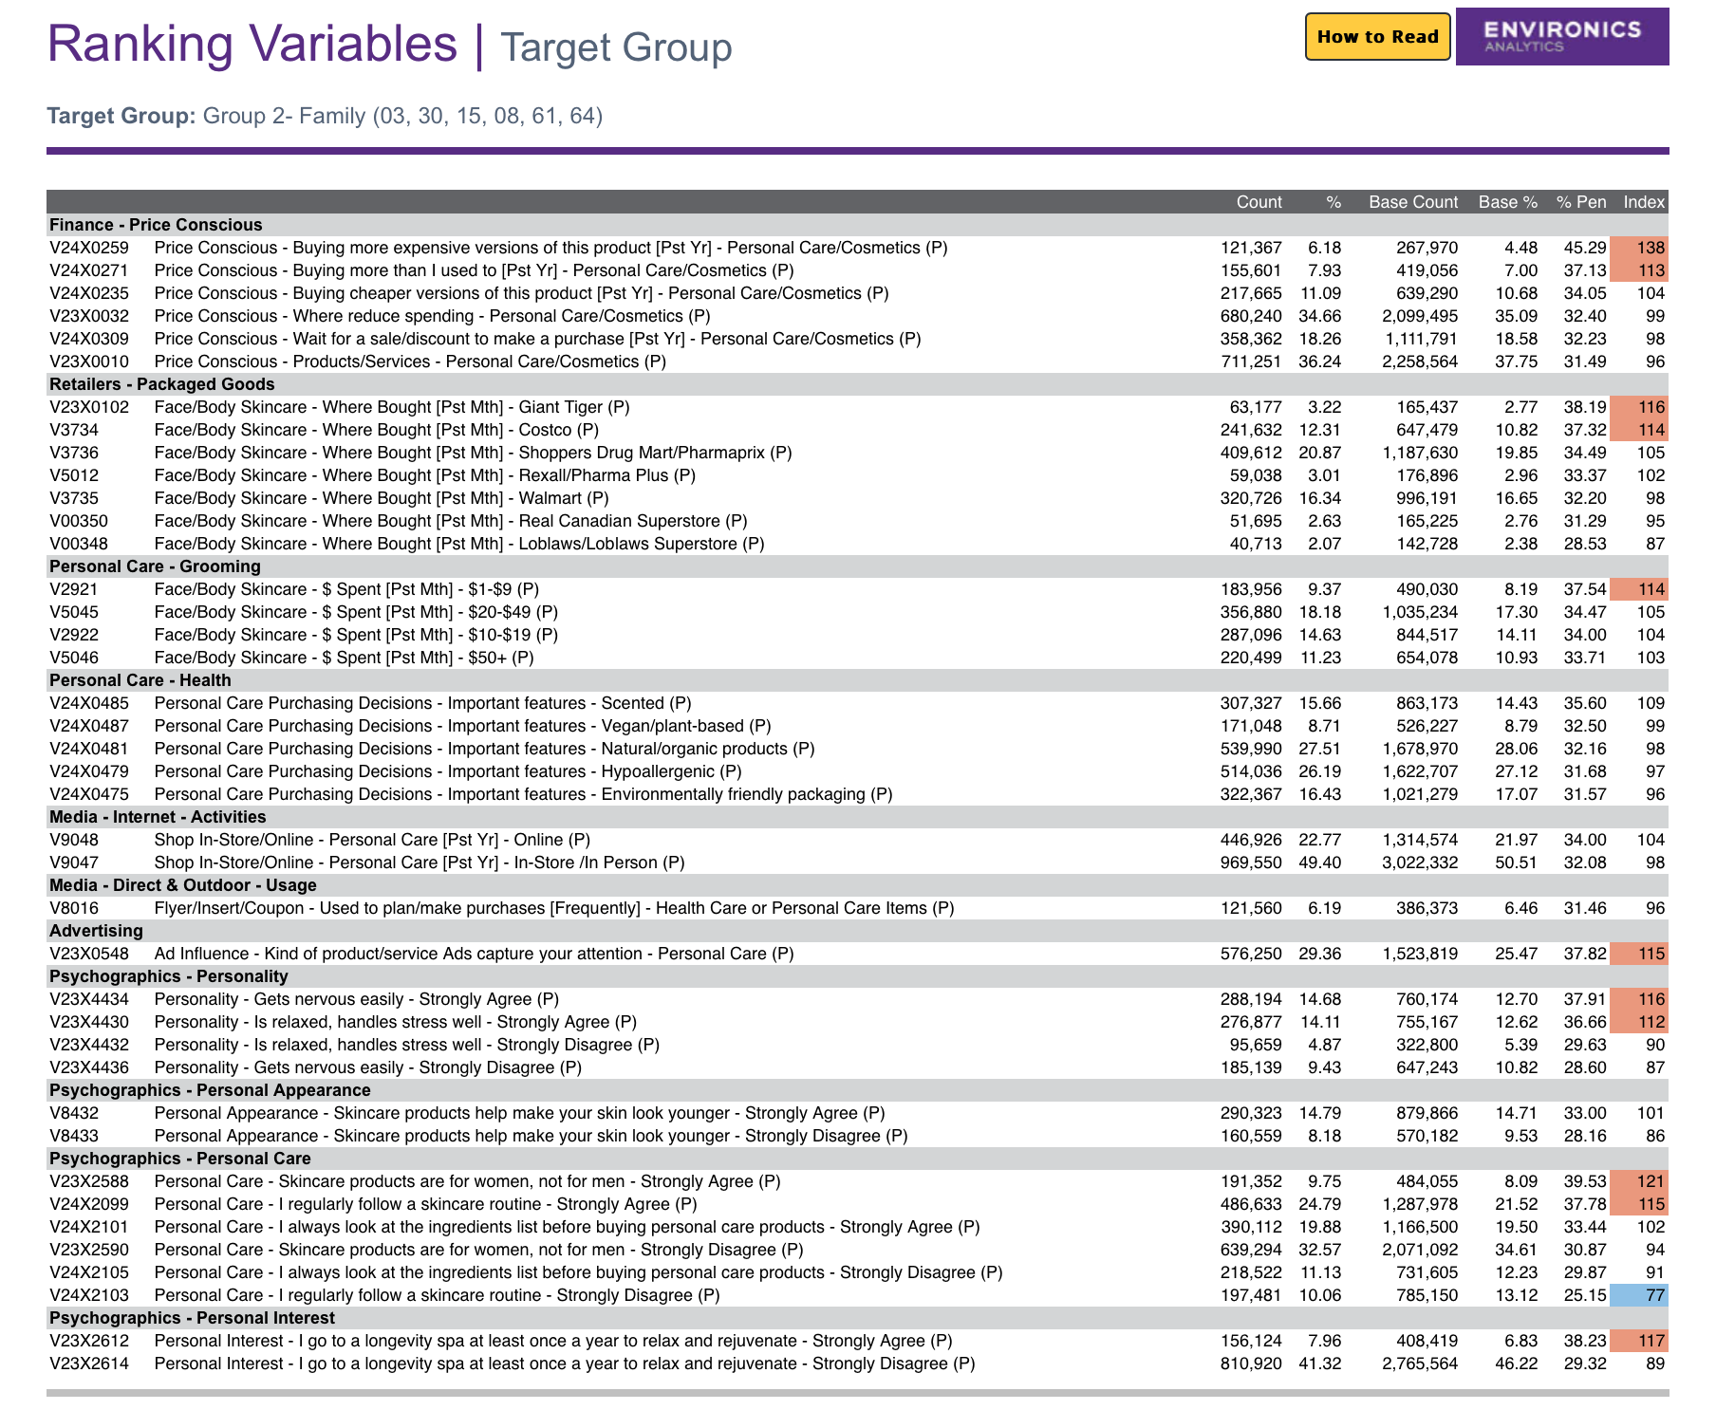
Behavioural

Slide 24
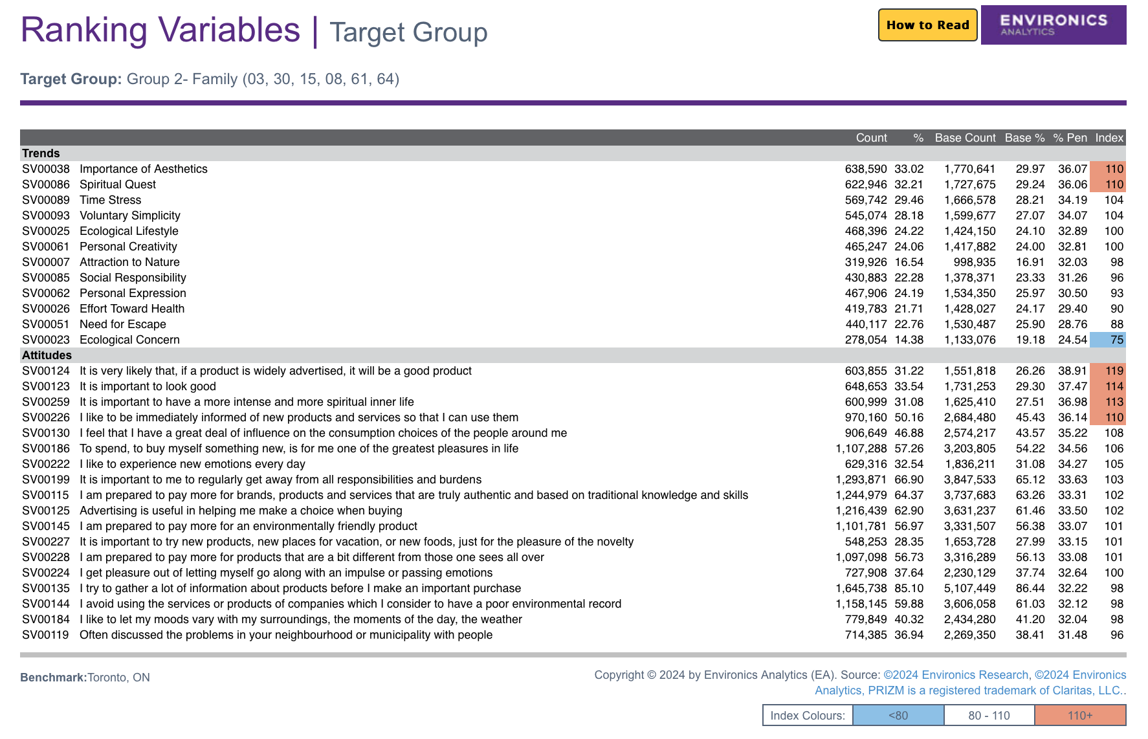
Social Values

Slide 25
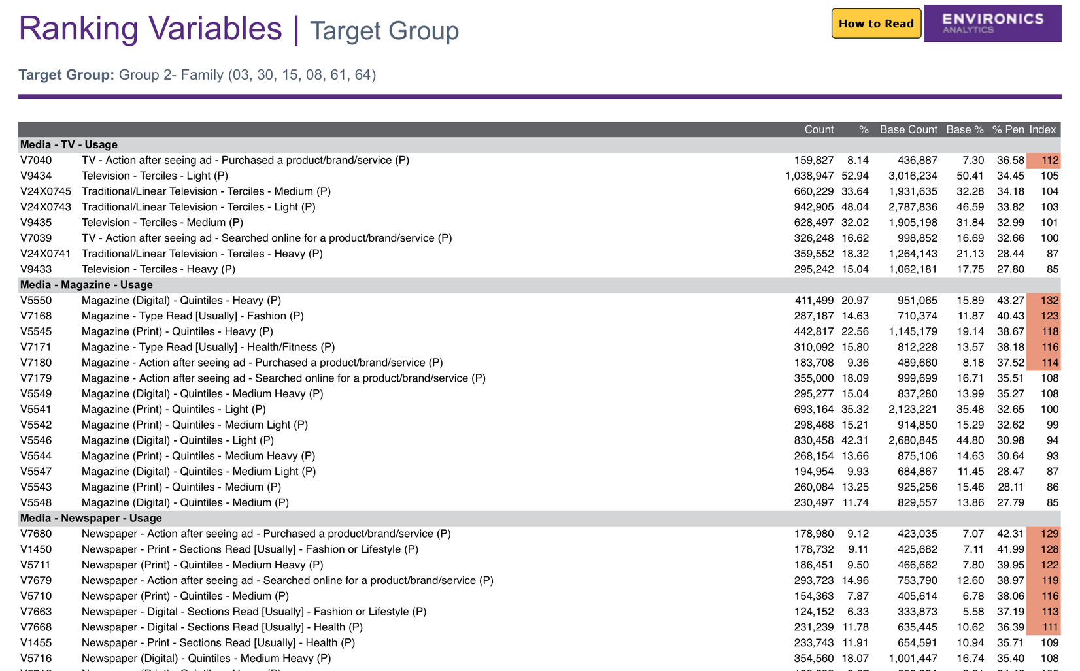
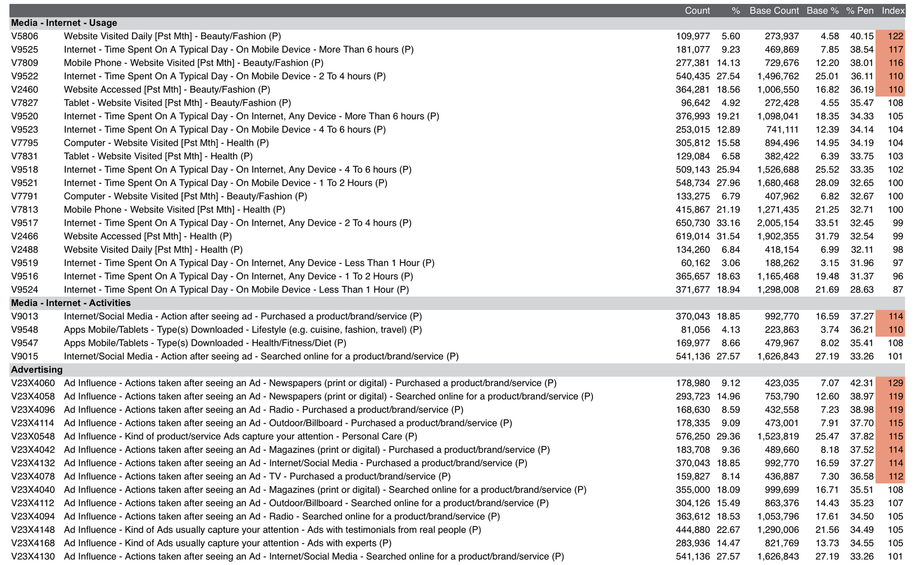
Media

Slide 26
Marketing Plan
PRODUCT
Core features:
Use of natural ingredients like essential oils (e.g., lavender, eucalyptus, and chamomile).
Free from harmful chemicals like parabens and sulfates, appealing to eco-conscious buyers.
Packaging:
Eco-friendly, recyclable, or biodegradable packaging.
Minimalist and premium design emphasizing sustainability and natural elements.
Unique Selling Proposition (USP):
Combines proven Dove skincare benefits with aromatherapy to promote stress relief and holistic wellness.
Appeals to both physical skincare needs and mental well-being.

Slide 27
PRICE
Pricing strategy:
Premium Pricing: Positioned as a high-quality product that justifies its price due to natural ingredients and eco-friendly practices.
Include smaller trial-sized packs for first-time users.
Bundles for aromatherapy kits to encourage higher spend per purchase.
Promotional Pricing:
CoInitial launch discounts (e.g., 20% off or bundled packages like “Buy 2, Get 1 Free”).
Subscription-based pricing for repeat buyers to encourage loyalty.

Slide 28
PLACE
Retail Channels:
Available at major retailers like Shoppers Drug Mart, Walmart, and eco-conscious boutiques in Toronto.
Collaborations with wellness and holistic spas to sell products on-site.
Online Channels:
Dedicated product pages on the Dove website with detailed information on sustainability and aromatherapy benefits.
Partnerships with e-commerce platforms like Amazon and wellness-oriented online marketplaces.
Local Focus:
Pop-up stores in high-traffic areas of Toronto to provide an immersive aromatherapy experience.
Leverage local eco-conscious events and markets for direct engagement with customers.

Slide 29
PROMOTION
Prime Target Group: Millennials (25–39)
Focus on urban professionals who value wellness and eco-conscious living.
Leverage their desire for stress relief and premium self-care experiences.
Secondary Target Group: Gen Z (18–24)
Engage younger audiences who are digitally active and open to experimenting with wellness-oriented products.
Promotional Strategies:
Content Marketing:
Create blogs and videos on topics like "The Benefits of Aromatherapy in Skincare" and "How to Build a Stress-Relieving Routine."
Share on platforms like YouTube, Instagram, and Pinterest.
Influencer Marketing:
Partner with wellness influencers and eco-conscious bloggers for authentic product reviews and demonstrations.
Focus on Toronto-based influencers for local relevance.

Slide 30
PROMOTION
Social Media Campaigns:
Launch a hashtag campaign like #RelaxWithDove or #WellnessInEveryDrop.
Engage users with Instagram Reels and TikTok challenges showcasing stress-relief routines.
Retail Promotions:
In-store promotions with testers to let customers experience the aromatherapy scents.
Free gifts with purchase (e.g., travel-size body lotion).
Events and Partnerships:
Sponsor wellness retreats or yoga events in Toronto with product samples.
Collaborate with eco-conscious organizations to promote the product's sustainability features.
Advertising:
Run targeted ads on social media platforms like Instagram and Facebook highlighting the eco-friendly and stress-relief benefits.
Use Google Ads to reach audiences searching for wellness or aromatherapy products.

Slide 31
PROMOTION
Key Differentiators for Promotion
Focus heavily on storytelling: emphasize Dove’s commitment to sustainability and well-being.
Highlight the emotional connection of stress relief, relaxation, and self-care through aromatherapy.

Slide 32
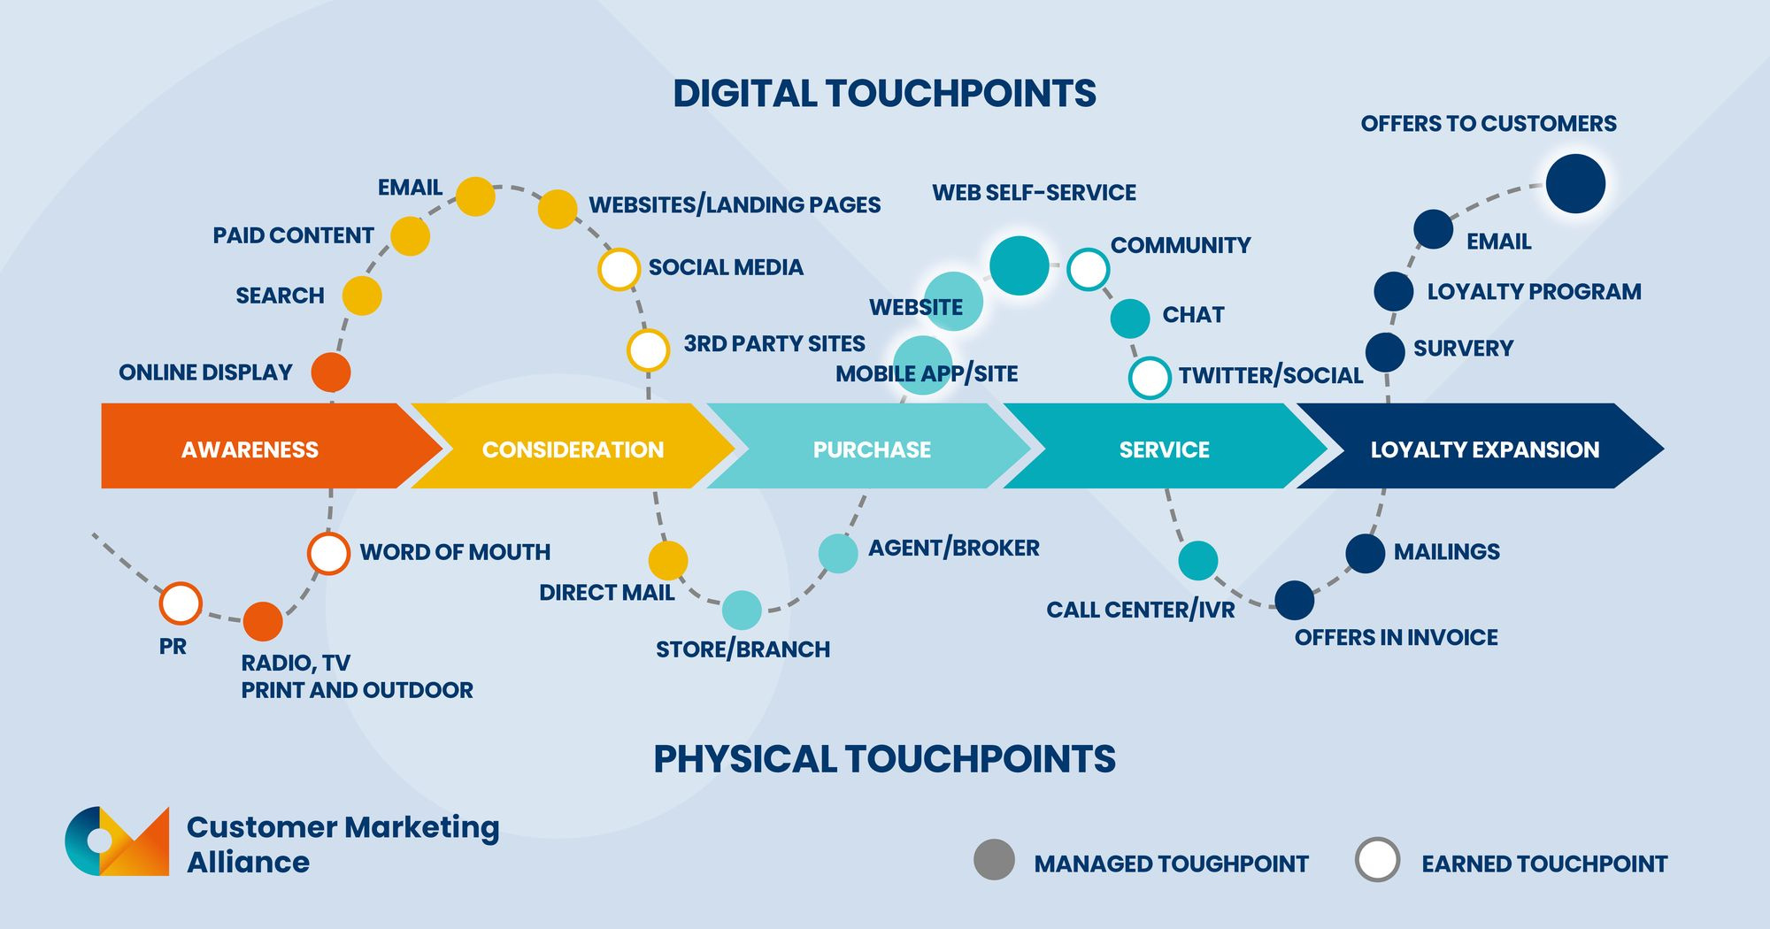
Customer Journey

Slide 33
Stage 1: Awareness
Objective: Increase brand visibility and introduce the concept of “Relaxation & Wellness” associated with Dove.
Platforms:
Instagram:
Run visually soothing ad campaigns featuring serene settings (e.g., spa-like bathrooms, tranquil nature scenes).
Collaborate with influencers in wellness and beauty niches to share their “Relaxation with Dove” moments.
Launch the hashtag #DoveWellnessMoments to encourage users to share their own relaxation routines.
YouTube:
Create a series of short videos titled “Wellness Stories” featuring individuals transforming their self-care moments with Dove products.
Promote the series with targeted pre-roll ads.
Facebook:
Share behind-the-scenes content of campaign creation to build authenticity.
Visuals & Themes:
Calming pastel color palettes.
Imagery of bubbles, smooth textures, and flowing water to evoke tranquility.
Uplifting taglines like “Find Your Calm with Dove” or “Your Everyday Escape.”

Slide 34
Stage 2: Engagement
Objective: Build meaningful connections and encourage audience interaction.
Platforms:
Instagram Stories & Reels:
Host interactive polls (e.g., “What’s your favorite way to relax?”) and Q&A sessions on relaxation tips.
Share short, creative Reels of “Self-Care Sundays” using Dove’s products.
TikTok:
Introduce challenges like “7-Day Relaxation Challenge” where users post short clips of their relaxation routines using Dove products.
Use trending sounds with customized captions promoting wellness.
Pinterest:
Pin boards featuring relaxation tips, spa day ideas, and self-care routines with Dove.
Visuals & Themes:
User-generated content with the hashtag #DoveZenZone.
Bright yet calming imagery that reflects real people enjoying serene moments.

Slide 35
Stage 3: Conversion
Objective: Drive product purchases and deepen brand association with wellness.
Platforms:
E-commerce Sites & Ads:
Feature discount codes for “Relaxation Bundles” of Dove products.
Create targeted Google ads linking to product pages with the tagline “Bring Wellness Home.”
Instagram and Facebook Shop:
Add shoppable posts for easy checkout from social media platforms.
Visuals & Themes:
Close-up product shots with captions highlighting their nourishing and calming benefits.
Testimonials from wellness influencers.

Slide 36
Stage 4: Retention
Objective: Foster loyalty and encourage repeat engagement.
Platforms:
Email Campaigns:
Send newsletters featuring exclusive relaxation tips, product sneak peeks, and loyalty rewards.
Dove Community App:
Offer guided meditation sessions or relaxation podcasts co-branded with Dove.
Visuals & Themes:
Relaxation-themed templates for emails.
Personalized thank-you messages for customer loyalty.

Slide 37
Campaign Ideas
Storytelling-Based Campaign
Concept: Highlight real-life stories of people integrating relaxation into their routines with Dove products.
Execution:
Video Series: Create a mini-series featuring diverse individuals (e.g., a busy parent, a working professional, a student) sharing their moments of peace and self-care using Dove.
Social Media Features: Post snippets of these stories on Instagram Reels, YouTube Shorts, and TikTok, showcasing simple self-care habits.
Interactive Posts: Encourage followers to share their personal relaxation stories with the hashtag #FindYourPeaceWithDove for a chance to be featured.
Visuals & Themes:
Cozy, intimate settings like candle-lit baths, serene nature backdrops, or calming evening routines.
Use soft lighting and soothing music to create an emotional connection.

Slide 38
Influencer Partnerships
Concept: Collaborate with wellness and lifestyle influencers to demonstrate self-care routines featuring Dove products.
Execution:
Product Tutorials: Influencers share their personal relaxation rituals, integrating Dove’s “Relaxation & Wellness” products.
Behind-the-Scenes Content: Show influencers’ authentic moments of self-care, adding a relatable and trustworthy element to the campaign.
Giveaways: Partner with influencers for relaxation kit giveaways, including Dove products and wellness accessories (e.g., candles, bath salts).
Potential Influencers:
Wellness advocates (e.g., yoga instructors, meditation coaches).
Beauty and lifestyle bloggers who align with Dove’s brand values.
Visuals & Themes:
Natural, candid content showing influencers in their daily environments.
Caption prompts like “What does relaxation mean to you?” to spark engagement.

Slide 39
Virtual Relaxation Events
Concept: Host branded online events to create a shared community experience focused on wellness.
Execution:
Yoga Sessions: Organize live virtual yoga classes led by professional instructors, incorporating Dove’s messaging.
Meditation Workshops: Partner with mindfulness experts to host guided meditation sessions, emphasizing self-care.
DIY Wellness Tutorials: Teach attendees how to create spa-like experiences at home with Dove products.
Event Features:
Exclusive event kits (Dove products, yoga mats, etc.) for early registrants.
Real-time interactions and Q&A sessions with instructors.
Recording access for participants to revisit sessions.
Visuals & Themes:
Branding on virtual backgrounds (e.g., “Dove Zen Zone”).
Relaxing colors and calming animations to enhance the virtual atmosphere.

Slide 40
Metrics for Dove
Key Performance Indicators (KPIs)
To measure the success of the “Relaxation & Wellness” campaign, the following KPIs will be tracked:
Social Media Engagement:
Metrics: Likes, comments, shares, hashtag usage (#DoveWellnessMoments, #FindYourPeaceWithDove), and follower growth.
Target: Achieve a 25% increase in engagement rates and 10,000 hashtag mentions within the first three months.
Sales Growth:
Metrics: Monthly sales volume of “Relaxation & Wellness” product lines.
Target: Drive a 15% increase in sales within six months.
Event Participation:
Metrics: Number of attendees in virtual events (yoga sessions, meditation workshops).
Target: Secure at least 2,000 participants across all events.
Customer Feedback:
Metrics: Net Promoter Score (NPS), product reviews, and survey responses.
Target: Maintain an NPS of 80 or higher and achieve a 90% positive feedback rate on product reviews.

Slide 41
Budget estimates
Expense Category | Estimated Cost | Details
Digital Advertising | $20,000 | Instagram, YouTube, TikTok campaigns.
Influencer Partnerships | $15,000 | Collaborations with 10 influencers.
Virtual Events | $5,000 | Hosting fees, instructor payments.
Content Creation | $10,000 | Professional photography and video shoots.
Product Giveaways | $3,000 | Kits for influencers and event attendees.
Miscellaneous | $2,000 | Contingency fund.
Total Budget | $55,000

Slide 42
Expected Return on Investment (ROI)
Projected Revenue Increase: $100,000 in additional sales over six months.
ROI Calculation: ROI = [(Revenue Increase - Campaign Cost) / Campaign Cost] × 100 = [($100,000 - $55,000) / $55,000] × 100 = 81.8% ROI

Slide 43
References
McKinsey & Company. (2024). The trends defining the $1.8 trillion global wellness market in 2024. Retrieved from https://www.mckinsey.com
StartupTalky. (n.d.). Dove marketing strategy - How it stands out among its competitors. Retrieved from https://startuptalky.com
Course Sidekick. (n.d.). Analyzing Dove: A comprehensive five C analysis. Retrieved from https://www.coursesidekick.com
IIDE. (2024). Exclusive marketing strategy of Dove in detail. Retrieved from https://iide.co
Syracuse University. (n.d.). The effectiveness of the Dove Campaign for Real Beauty in terms of brand building. Retrieved from https://surface.syr.edu
Cal Poly Digital Commons. (n.d.). The Dove Real Beauty campaign: How does it wash. Retrieved from https://digitalcommons.calpoly.edu
Dove. (n.d.). Dove care campaigns in action. Retrieved from https://www.dove.com
ResearchGate. (n.d.). The effectiveness of Dove Campaign for Real Beauty in affecting customers' purchase decision toward Dove products. Retrieved from https://www.researchgate.net
Medium. (n.d.). How Dove created one of the most efficient marketing campaigns on record. Retrieved from https://medium.com
Statista. (2023). Skin care market in Canada. Statista. https://www.statista.com/outlook/cmo/beauty-personal-care/skin-care/canada
Statista. (2023). Beauty & personal care market in Canada. Statista. https://www.statista.com/outlook/cmo/beauty-personal-care/canada
Fortune Business Insights. (2023). Skincare market. Fortune Business Insights. https://www.fortunebusinessinsights.com/skin-care-market-10254

Slide 44
Thank You

